Slide 1
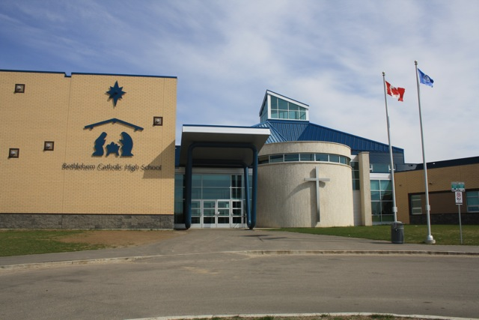

Course Selection for 2026-2027
Bethlehem Catholic High School
Notes:
Remove supported math classes; add those in beforehand
Build in to go through each area and have students select as go
Check before post
Course registration handbook open , show where
Slide QR code
Edf take cca10 in grade 10
Transcripts show funnel

Slide 2
GOALS For Today
Learn about graduation requirements
Learn about classes offered at Bethlehem
Select courses for the 2026-2027 school year

Slide 3
Course Selection
Course Selection opens:
Monday, February 9
Course Selection closes:
Wednesday, February 25 at midnight
This course selection PowerPoint will be uploaded onto our school website along with log in instructions and how to find your transcript instructions.
You will be selecting your courses today. You will have access to make changes until Wednesday, Feb 25.

Slide 4


The classes you choose to take in High School Influence What You Can Study in Post-Secondary & what you can do for Work After High School
High School offers a variety of subjects…
You may be uncertain of your career choice right now….
but choosing the right subjects now will help widen your range of career opportunities.
so, choose ones that interest you, ones you will do well in, and ones that fit your personality and values.

Slide 5




School counsellors can provide students with tools & opportunities to match their skills, interests & values with careers.
This helps with course selection in high school.
1. MyBlueprint: myblueprint.ca
2. SIEC: saskatooniec.ca/programs
By accessing your
MyBlueprint account, you can use your grad planner to map out your future classes.

Slide 6




Post Secondary
If, after graduation, you plan to attend a post-secondary institution, be sure to look at their requirements.
You will need certain high school pre-requisites to take certain post-secondary classes/programs.

Slide 7
Once you have an idea of the careers that interest you & the schooling required, you can begin to make your high school plan.
Required Courses VS
Elective Courses
In Grades 10-12 there are 14 REQUIRED classes you must take.
There are a minimum of 10 ELECTIVE classes you choose to take.
TOGETHER they must add up to 24 credits to earn a Grade 12 standing.

Slide 8
Courses
If this year you are taking:
  Bridge, Supported or Stretched Math
  EAL English, Language classes or tutorial
  Learning Assistance tutorial
  Modified classes
  Please speak to your teacher, a counsellor or administrator regarding your course selection.

Slide 9
Advanced Placement
It provides an opportunity to earn a university credit in Grade 12.
English A30P, Studio Art 30P and Psychology 30P are offered.
French Immersion 30P is available. Ask your French Immersion teacher for more information as you don’t select this as a course.

Slide 10
English Advanced
Grade 10 | Grade 11 | Grade 12
ELA10A | ELA20A | ELB30P
 |  | ELA30P (AP Prep)
Grade 9s looking to challenge themselves in understanding literature and writing are encouraged to sign up for English 10 Advanced.
If you are looking for an enriched environment and you meet the desired criteria for academic ability, responsibility, and creative & critical thought, you will thrive in English 10 Advanced.
Select ELA10 for next year. If interested in English 10 Advanced, then fill out an application and submit it to your current English teacher.
Notes:
Process: letter and expression of interest from English teacher, writing sample, permission from parents, teacher signature
What makes a good student for the advanced English program?
Enjoys reading and writing
Enjoys discussions, critical thinker, challenges themselves
What are the benefits to participating in the advanced English program?
Could get university credit
Better prepared for university
Close community (similar to French Immersion); like minded and ability students
Analytical and writing skills improve
More focused, faster pace, higher level of thinking than what is expected by the criteria

Slide 11
Prerequisites
You are responsible for ensuring that you have the required prerequisite course for any class you select.
Be sure to refer to the 2026-2027 Course Selection Booklet on our school website for all course descriptions and prerequisites.

Slide 12
Mathematics
Mathematics 90 Program
Math 11
Math 21
Workplace & Apprenticeship 20
(MWA 20)
Workplace & Apprenticeship 30
(MWA 30)
Workplace & Apprenticeship Mathematics 10 (MWA 10) AND/OR
Foundations of Mathematics & Pre-Calculus 10 (MFP 10)
Foundations of Mathematics 20
(MFO 20)
Foundations of Mathematics 30
(MFO 30)
Pre-Calculus 20
(MPC 20)
Pre-Calculus 30
(MPC 30)
Calculus 30
(CAL 30)
Students can’t jump from one pathway to another.
    *The graduation requirement for Mathematics is one 20 level course.

Slide 13
Math
Most students who wish to take MPC20 are recommended to take MFO20 first!
If you request both for next year, please check you schedule to see if MFO20 is in Semester 1
    If it isn’t, contact a counsellor or administrator to explore a schedule change

Slide 14
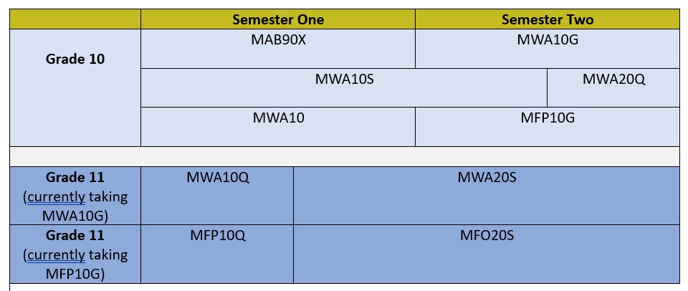
Stretched Math

Slide 15
Science
Strong math skills are necessary for Chemistry 30 and Physics 30
Science 10
Computer Science 20
Health Science 20
Physical Science 20
Physics 30
Chemistry 30
Biology 30
Environmental Science 20
Earth Science 30
Biology 30
Computer Science 30
Earth Science 30

Slide 16
Class Planning: English
GRADE 10 | GRADE 11 | GRADE 12
Catholic Studies 10 | Catholic Studies 20 | Catholic Studies 30
English Language Arts 10 | English Language Arts 20 | English Language Arts 30
Financial Literacy 10 | One Math 20 | History OR Indigenous Studies 30
Math Foundations & Pre-Calc 10 AND/OR Math Workplace and Apprenticeship 10 | One Science 20 | **two additional 30 level classes required 1
Science 10 | 1 | 2
History OR Indigenous Studies 10 | 2 | 3
Wellness 10 (Phys. Ed.) | 3 | 4
1 | 4 | 5
2 | 5 | 6
3 | 6 | 7
** you need a minimum of 24 credits to graduate

Slide 17
Class Planning: French
GRADE 10 | GRADE 11 | GRADE 12
Français immersion 10 | Français immersion 20 | Français immersion 30
Etudes catholiques 10 | Etudes catholiques 20 | Etudes catholiques 30
English Language Arts 10 | English Language Arts 20 | English Language Arts 30
Fondements de mathématiques et précalcul 10 | Fondements de mathematiques 20 | Sciences sociales immersion 30
Science 10 | one Science 20 | **one additional 30 level class 1
Histoire 10 | French elective | 2
Wellness 10 | 1 | 3
Littératie financière 10 | 2 | 4
1 | 3 | 5
2 | 4 | 6
** you need a minimum of 24 credits to graduate
Notes:
12 French credits at the gr. 10-12 level are required for a Bilingual certificate.
Littératie financière 10 is required and MAY take the place of one of your French credits in the 2025-26 school year.
Looking forward to Grade 11…. 4 required FR Immersion courses:
1. Etudes catholiques 20
2. Français immersion intégré B20
3. Français immersion 20
4. Histoire 20 OR Fondements de mathematiques 20 ( Bethlehem will only offer ONE. We will decide Spring of 2024 which one that will be). Most likely it will be Histoire20 and therefore Math will only be offered in English.

Slide 18
Honour Roll English
GRADE 10 | GRADE 11 | GRADE 12
Catholic Studies 10 | Catholic Studies 20 | Catholic Studies 30
English 10 | English 20 | English 30
History OR Indigenous Studies 10 | one Math 20 | History OR Indigenous Studies 30
Financial Literacy 10 | one Science 20 | one Math 30
one Math 10 | Level 20 elective | one Science 30
Science 10 | Level 20 elective | Level 30 elective
Level 10 elective | Level 20 elective | Level 30 elective
Notes:
Grade 12 Honor Roll is decided at the second semester midterm reporting period for all classes, including cyber classes.

Slide 19
Honour Roll French
GRADE 10 | GRADE 11 | GRADE 12
Études catholiques 10 | Études catholiques 20 | Études catholiques 30
English 10/ Français immersion 10 | English 20/ Français immersion 20 | English 30/ Français immersion 30
Histoire 10 | one Math 20 | Sciences sociales immersion 30
Littératie financière 10 | one Science 20 | one Math 30
Fondements de mathématiques et précalcul 10 | Level 20 elective | one Science 30
Science 10 | Level 20 elective | Level 30 elective
Level 10 elective | Level 20 elective | Level 30 elective
Notes:
Grade 12 Honor Roll is decided at the second semester midterm reporting period for all classes, including cyber classes.

Slide 20
Electives Video & Descriptions
Holocaust & Genocide Studies 20L
This course examines how modern genocides occur, focusing on the Holocaust. Students explore how social conditions, propaganda, and human behaviour can lead to persecution and mass violence, and how international human rights laws formed in response. Case studies including the Armenian Genocide, the Holodomor, the Holocaust, and other recognized genocides, help students understand the development of international law and the challenges of preventing future atrocities.
Creative Writing 30L
Creative Writing 30 allows students to develop their personal writing voice while exploring forms such as poetry, short fiction, creative nonfiction, and multimedia storytelling. The course emphasizes the writing process, drafting, revising, and refining work, while encouraging creativity and experimentation.

Slide 21
Electives - Grade 10
Band 10
Choral 10
Dance 10
Drama 10
Football 10 NEW
Guitar 10
Visual Arts 10
Visual Arts 10 Advanced NEW
Wellness 10 Basketball NEW
Ukrainian Language Arts 10
Career Work Exploration 10 & 20*
Clothing Textiles & Fashion 10
Commercial Cooking 10
Communication Media 10
Construction & Carpentry 10
Drafting and Computer Aided Design 10
Photography 10
Robotics & Animation 10
Welding 10 If possible, students should complete Construction 10 first. Gr 11 and 12 students have first priority to WDA10 but if there is space, Grade 10 students can take WDA10.

Slide 22
Electives - Grade 11
Band 20
Choral 20
Dance 20
Drama 20
Printmaking 20 (AED20) NEW
Sculpture 20 (AED20) NEW
Theatre Arts 20 NEW
Visual Arts 20
Visual Arts 20 Advanced NEW
Creative Writing 20
Film Studies 20 NEW
Ukrainian Language Arts 20
Active Living & Fit. Leadership 20
Basketball 20 NEW
Competitive Sports 20
Football 20 NEW
Non-travel / Stay P.E. 20
Recreation & Leisure 20
Animation 20
Cabinet Making 20 (CCA10 pre-req)
Career Work Exploration (10&) 20
Clothing, Textiles and Fashion 20
Commercial Cooking 20
Communication Media 20
Drafting & CPU Aided Design 20
Entrepreneurship 20
Financial Literacy 20
Graphic Arts 20
Mental Health & Well-being 20L
Photography 20
Robotics & Automation 20
Welding A20 (WDA10 pre-req)
Wildlife and Habitat Studies 20
* Basketball 20, Competitive Sports 20, Non-travel / Stay 20 & Rec & Leisure 20 are the same credit

Slide 23
Electives - Grade 11
Math Options:(one required to graduate):
Foundations 20
Pre-Calculus 20
Workplace & Apprenticeship 20
Science Options: (one required to graduate):
Computer Science 20
Environmental Science 20
Health Science 20
Physical Science 20
Social Science Options:
History 20
Holocaust & Genocide Studies 20 NEW
Indigenous Studies 20
Psychology 20
Sports Psychology 20 NEW
French Elective Options:
Cuisine Commerciale 20 NEW
Photographie 20 NEW
Psychologie 20 NEW

Slide 24
Electives - Grade 12
Band 30
Choral 30
Creative Writing 30 NEW
Dance 30
Drama 30
Guitar 30
Printmaking 30 (AED30) NEW
Sculpture 30 (AED30) NEW
Studio Art 30 P NEW
Theatre Arts 30 NEW
Visual Arts 30
Visual Arts 30 Advanced NEW
Ukrainian Language Arts 30
Creative Writing 30 NEW
Active Living & Fit Leadership 30
Basketball 30 NEW
Competitive Sports 30
Football 30 NEW
Non-travel / Stay P.E. 30
Recreation & Leisure 30
Animation 30
Cabinet Making 30 (CMA20 pre-req)
Career Work Exploration A30/B30
Clothing, Textiles and Fashion 30
Entrepreneurship 30 (ENT20 pre-req)
Financial Literacy 30 (FLI20 pre-req)
Food Studies 30
Graphic Arts 30
Hairstyling & Esthetics 30
Mental Wellness 30
Photography 30
Welding A30 (WDA20 pre-req)
* Basketball 30, Competitive Sports 30, Non-travel / Stay 30 & Rec & Leisure 30 are the same credit

Slide 25
Electives - Grade 12
Math Options:
Calculus 30
Math Foundations 30
Math Pre-Calculus 30
Math Workplace & Apprenticeship 30
Science Options:
Biology 30
Chemistry 30
Computer Science 30
Earth Science 30
Physics 30
Social Science Options:
Law 30
Psychology 30
Psychology 30P

Slide 26
Band Students
Grade 10 Band is paired with Wellness 10:
Select BAN10N and BWE10N
Grad 11 & 12 Band is paired with Catholics Studies
Select BAN20N and CST20N
Select BAN30N and CST30N

Slide 27
Choral
This is a year-long class that can be an 11th credit.
Choir meets 2 to 3 times a week at lunch time.
  For Grade 10, select CHO10N
  For Grade 11, select CHO20N
  For Grade 12, select CHO30N

Slide 28
Career and Work Education
CWE will be offered in Pd 4 and 5 - students MUST commit to both. Students will earn 2 credits: CWE10 & CWE20
CWA30 & CWB30
The class is a combination of classroom hours and workplace hours.
Must have your own transportation to workplace (drive, ride from family member, or public transportation).

Slide 29


Emergency Services Programs
If you interested in participating in the Fire Cadet or Police Cadet programs, please select FPC20 (in Arts & PAA Folder)
  This course takes up 2 course slots in your schedule – make your other selections accordingly
Successful applicants will take part in these opportunities in Sem 2 as part of CWA30 and CWB30 courses for credit
If you have any questions, please ask Mr. Boechler

Slide 30

ED Feehan
Construction Program
If interested, please register in:
  Construction & Carpentry
    EDFCN1, EDFCN2 (Sem 1 options)
  Interior Finishing
    EDFCN3, EDFCN4 (Sem 2 options)
If you have questions, please ask, please see admin, counselors, or Mr. Junk/Mr. Roesler

Slide 31
Class offerings
Classes are offered based on the number of students that sign up.
When selecting a class, ensure it is the class you wish to take as there will be minimal class changes next fall.

Slide 32
Class offerings
If less than a class size registers for a class, then it will not be offered.
If you select a class at a different grade level, you may not get to take the class (e.g., a Grade 11 student selects Chemistry 30. Grade 12 students would have priority).

Slide 33
CYBER SCHOOL CLASSES
You can’t choose Cyber School classes in your online course registration
If you are taking a cyber class this year and are unable to register for a course, then speak with a counsellor or administrator.
List of classes offered and registration www.gscs.ca/cyber

Slide 34
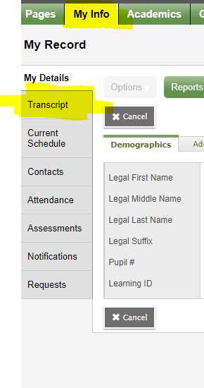

School Transcript in My School Sask (MSS)
Click on the MSS Icon in your GSCS Portal
Click on My Info Top Tab
Click on Transcript Side Tab

Slide 35
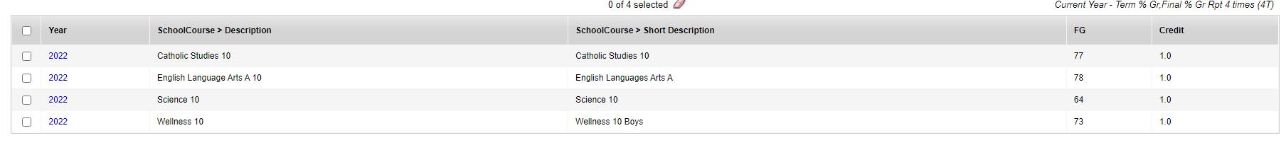
Viewing your School transcript
Transcript View
Credit Summary

Slide 36

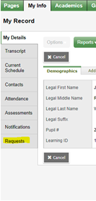
Course Selection - how to log in
1. Go to your Portal: portal.gscs.ca
2. Click on My School Sask.
3. Sign in using your student number email and password.
4. Once in, click on the top
tab My Info and then the
side tab Requests.

Slide 37
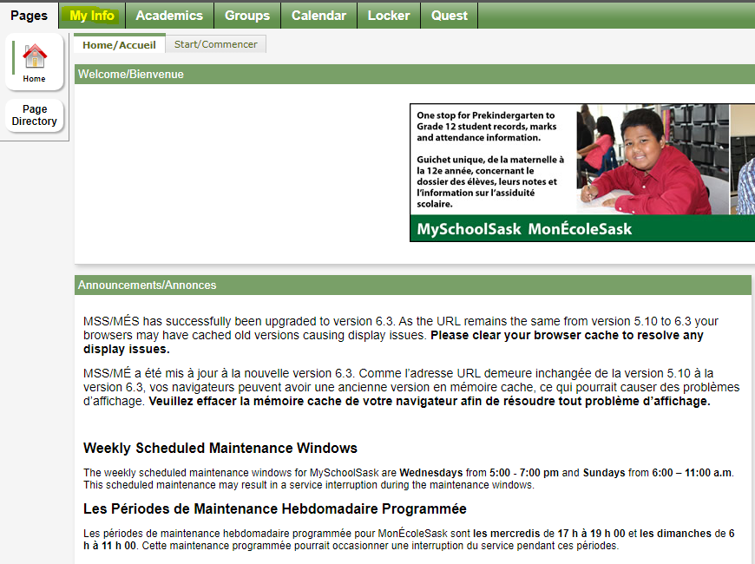
Course Selection - how to log in
3. When My School Sask opens, click on My Info

Slide 38
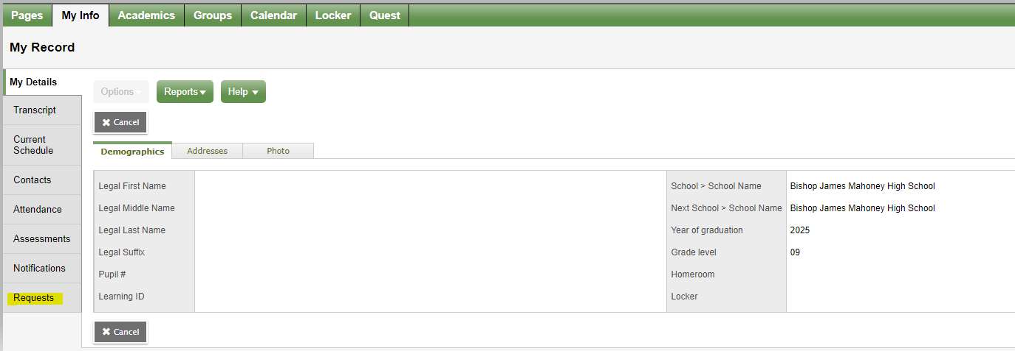
Course Selection - how to log in
4. Under the My Info heading, choose Requests..

Slide 39
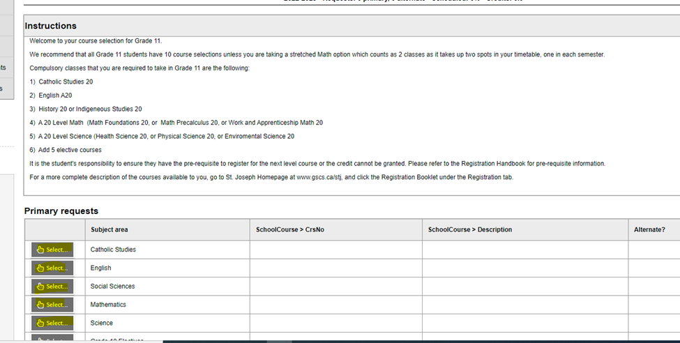
Course selection - continued
5. Read the Registration Instructions.

Slide 40
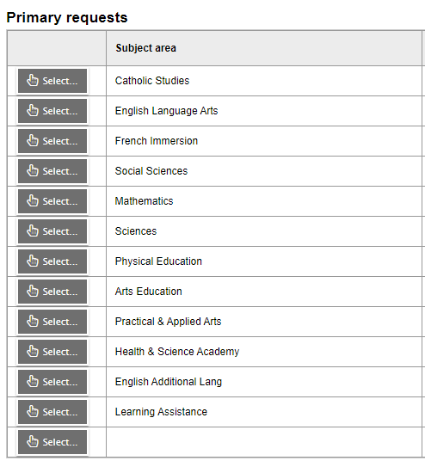

Course selection - continued
6. Scroll down under the Instructions to Primary requests. Click on
for each subject area..

Slide 41
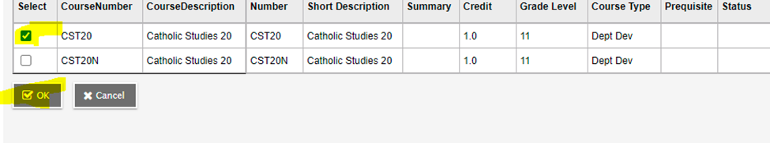
Course selection - continued
6. Select each subject area one by one at the bottom and select the course(s) you want to register in for next year.
7. Be sure to click OK after your make your selections.
8. Please select 2 Alternate Electives from the Alternate File.
9. When you are satisfied with your course selections, click POST.

Slide 42
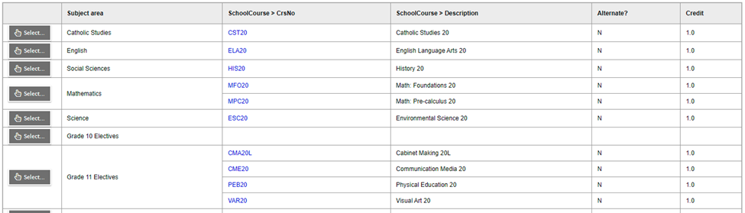
Course selection - continued
10. A list of your course requests for next school year will be listed in blue beside the Subject area under school course.

Slide 43
If you have any questions, please speak to
a counsellor or administrator.
Edits to your course selection can be made until Wed. Feb 25.
Thank You!!!

