Slide 1
E.D. Feehan Catholic High School Course Selection
Notes:
Welcome to ED Feehan’s Course Selection presentation for the 2021-22 school year.

Slide 2
AGENDA
To learn about requirements to graduate, according to your grade level.
To learn about courses offered at E.D. Feehan next year.
To plan for next year and select courses, both Required and Electives, that are needed to earn your graduation standing.
Continue to explore what you will do when you leave high school.
Notes:
The goal is to ensure you know about the requirements to graduate, learn about the classes we have at Feehan, and make a plan for next year.

Slide 3
CAUTION
YOU are responsible to ensure that you have earned the required prerequisite course for any course that you select.
The Ministry of Education withholds credits earned without the necessary prerequisite.
For further information - please refer to the online Registration Handbook that is on the EDF website for credit requirements, course descriptions and required prerequisites:
www.gscs.ca/EDF

Slide 4
Required / Elective Courses
Required courses are mandated by the Ministry of Education - all students must take them. It is your responsibility to ensure that you have these. If you have been unsuccessful OR have not taken a required course, you must sign up for it next year.
Elective courses are not required and are selected by each individual.
Both Required and Elective courses count towards the 24 credits needed to graduate.
LAS/EAL Tutorial classes do not count towards your 24 credits.

Slide 5
NOTE:
GRADE 10 COURSES are labelled as ‘10’.
i.e. One of the Grade 10 English courses is ELA10.
GRADE 11 COURSES are labelled as ‘20’.
i.e. One of the Grade 11 Math courses is MWA20.
GRADE 12 COURSES are labelled as ‘30’.
i.e. The Grade 12 History course is HIS30.
ANY COURSE ENDING IN A ‘1’ is a MODIFIED course.
i.e. MATH 11, ESC21, ELA21
*Students need parent/counsellor/LAT approval to enroll in modified classes*

Slide 6
Old Requirements
Required Courses
for students entering Gr. 12
(September 2025)

Slide 7
Required Courses at the 10 Level
Catholic Studies 10
English A10 (or modified is ELA11)
English B10 (or modified is ELB11)
History 10 (HIS11) OR Indigenous Studies 10 (IST11)
Science 10 (SCI11)
Wellness 10
Math: Foundations & Pre-Calculus 10 OR
Math: Workplace & Apprenticeship 10 (or Math 11)
Notes:
Here are the required Grade 10 courses

Slide 8
Required Courses at the 20 Level
Catholic Studies 20
English 20 (ELA21)
History 20 (HIS21) or Indigenous Studies 20 (IST21)
A minimum of one 20 level Math (Math 21)
A minimum of one 20 level Science (ESC21)
Notes:
Here are the required Grade 11 courses

Slide 9
Required Courses at the 30 Level
Catholic Studies 30
English A30 (ELA31)
English B30 (ELB31)
History 30 (HIS31) OR Indigenous Studies 30 (IST31)
You need a minimum of 24 credits in order to graduate, 5 of which must be at the 30 level.
* Ministry requirements are listed on the back page of your registration package.

Slide 10
Important:
You must take at least one of the following Social Science classes:
History 20
Indigenous Studies 20
Psychology 30

Slide 11
Graduation Requirements for Students Entering Gr. 12 in Sep 2025 (Yellow = Electives)
GRADE 10 | GRADE 11 | GRADE 12
Catholic Studies 10 | Catholic Studies 20 | Catholic Studies 30
English A10 | English 20 | English A30
English B10 | A Minimum of 1 Level 20 Science | English B30
History 10 OR Indigenous Studies 10 | A Minimum of 1 Level 20 Math | History 30 OR Indigenous Studies 30
Math: MWA 10 OR MFP 10 | At least one of: History 20 OR Indigenous Studies 20 OR Psychology 30
Science 10 | 1 | 1
Wellness 10 | 2 | 2
1 | 3 | 3
2 | 4 | 4
3 | 5 | 5

Slide 12
SK New Requirements
Required Courses
for students entering Gr. 10 and 11
(September 2025)

Slide 13
Required Courses at the 10 Level
Catholic Studies 10
One English 10 class (ELA A10 or B10)
History 10 OR Indigenous Studies 10
Science 10
Wellness 10
Financial Literacy 10
Math: Foundations & Pre-Calculus 10 OR
Math: Workplace & Apprenticeship 10
*Note: Modified options are available for most required classes.
Notes:
Here are the required Grade 10 courses

Slide 14
Required Courses at the 20 Level
Catholic Studies 20
English 20
A minimum of one 20 level Math
A minimum of one 20 level Science
A 20-level Social Science (HIS/IST20) is no longer required, but can be taken as an elective.
*Note: Modified options are available for most required classes.
Notes:
Here are the required Grade 11 courses

Slide 15
Required Courses at the 30 Level
Catholic Studies 30
English 30
History 30 OR Indigenous Studies 30
*Note: Modified options are available
You need a minimum of 24 credits in order to graduate, 5 of which must be at the 30-level.
Ministry requirements are listed on the back page of your registration package

Slide 16
Graduation Requirements for Students Entering Gr. 10 or 11 in Sep 2025 (Yellow = Electives)
GRADE 10 | GRADE 11 | GRADE 12
Catholic Studies 10 | Catholic Studies 20 | Catholic Studies 30
English 10 | English 20 | English 30
Science 10 | A Minimum of 1 Level 20 Science | History 30 OR Indigenous Studies 30
Math: MWA 10 OR MFP 10 | A Minimum of 1 Level 20 Math | 1
History 10 OR Indigenous Studies 10 | 1 | 2
Wellness 10 | 2 | 3
Financial Literacy 10 | 3 | 4
1 | 4 | 5
2 | 5 | 6
3 | 6 | 7

Slide 17
Grade 10 Math Options
You need to take at least one Grade 10 Math:
Math: Workplace & Apprenticeship 10
Math: Workplace & Apprenticeship 10C (co-taught option)
Math: Foundations & Pre-Calculus 10
Math 11 (modified)

Slide 19
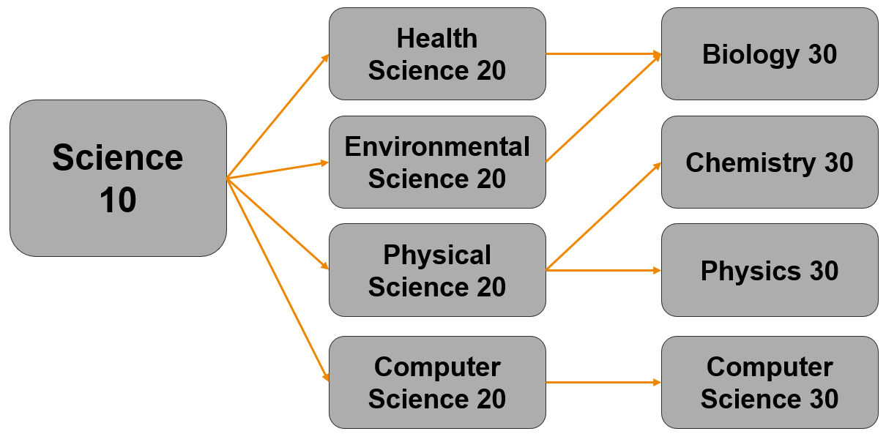
SCIENCE PATHWAYS
Notes:
1 LEVEL 20 MATH AND 1 LEVEL 20 SCIENCE ARE REQUIRED. ALL OTHER MATH AND SCIENCE CLASSES BEYOND THESE ARE ELECTIVES.
MATH AND SCIENCE ELECTIVES SHOULD BE CONSIDERED BASED ON FUTURE PLANS, ABILITY AND INTEREST.
IF YOU ARE INTERESTED IN TAKING A 20 LEVEL SCIENCE IN GRADE 10, YOU MUST HAVE AN 80 PERCENT AVERAGE IN YOUR GRADE 9 SCIENCE AND MATH COURSES. AS WELL YOU WILL BE EXPECTED TO MAINTAIN AN 80 PERCENT AVERAGE IN YOUR GRADE 10 SCIENCE AND MATH COURSES IN TERM 1 OF NEXT YEAR.

Slide 20
The next few slides are for every one

Slide 21
Elective Offerings at E.D. Feehan High School
Elective classes are offered based on the number of students that sign up.
Choose wisely! If enrolment for a class is too low, it will not be offered.
Due to EDF scheduling - Requests to change timetables are not always possible.

Slide 22
Electives Fine Arts Note: A Fine Art can be used in calculating a university entrance average and as a pre-req for some colleges
Visual Arts 10, 20, 30
Band 10, 20, 30
Guitar 10, 20, 30
Rock Band (Music) 20, 30 (Guitar 10 is pre-req)
Drama 10, 20, 30
Choral 10, 20, 30
Arts Education 10, 20, 30
Note:
Certain classes have additional fees attached.

Slide 23
Practical and Applied Arts
Construction & Carpentry 10, Industrial Arts 20, 30 (in the Shop)
Welding 10, 20, 30
Construction 20, 30 (House Build Sem 1)
Interior Finishing 20, 30 (House Build Sem 2)
Food Studies 10, 20, 30
Clothing, Textiles & Fashion 10, 20, 30
Photography 10, 20, 30
Graphic Arts 20, 30
Robotics & Automation 10, 20, 30
Financial Literacy 20, 30
Theatre Arts 20, 30 (please note, this is a PAA course- not a Fine Art)
Note:
Certain classes have additional fees attached.

Slide 24
Other Electives
Career & Work Exploration 10/20 and A30/B30 (2 credits, 2 periods)
Creative Writing 20
Cree 10, 20, 30
Entrepreneurship 20, 30
Physical Education 20, 30
Psychology 30
Note:
Certain classes have additional fees attached.

Slide 25
Please note:
Career and Work Exploration (10 & 20 or A30 & B30)
Must be 16 years of age
Your own transportation is required
Is a two-credit class which takes two periods in one semester
Construction Program 20, 30 and Interior Finishing 20, 30
(building of the house)
Is a two-credit class which takes two periods in one semester
Must have Construction & Carpentry 10 prerequisite
Includes participation in Saskatchewan Youth Apprenticeship (SYA)
Possible Saskatchewan Youth Internship opportunities

Slide 26
Learning Assistance Tutorial
Learning Assistance tutorial is a non-credit class that supports academic success.
If you have questions about Learning Assistance, please talk to Mrs. McAllister, Mr. Pawluk, a school counsellor or administrator

Slide 27
EAL Tutorial
EAL courses can be found on the back of your Course Selection Card.
EAL tutorial is a non-credit class that supports academic success​
If you are currently connected to EAL classes, you will be discussing this option with Ms. Nakutnyy and Ms. Cassidy​

Slide 28
EAL Program
Sheltered English is a required regular course that provides additional support for students in the EAL program
Electives courses for EAL students are:
These courses are for beginning English language learners.
It provides support for language development and strengthening skills to support mainstream academic classes.
*See EAL teachers to see if this an appropriate option for you.

Slide 29
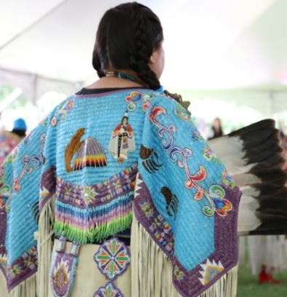
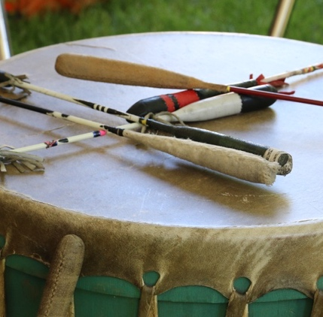
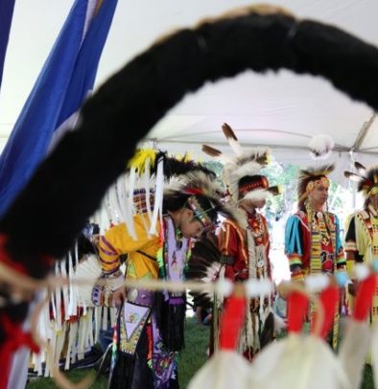
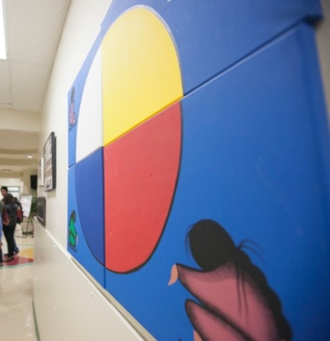
miyo pimâcihowin Indigenous Cultural & Wellness Program
This program is focused on providing a great academic environment coupled with Indigenous cultural and wellness programming allowing each student to work toward their personal goals.
This program will focus on integrating Indigenous culture, ways of knowing, spirituality, extra supports, and land-based learning opportunities into the courses.

Slide 30
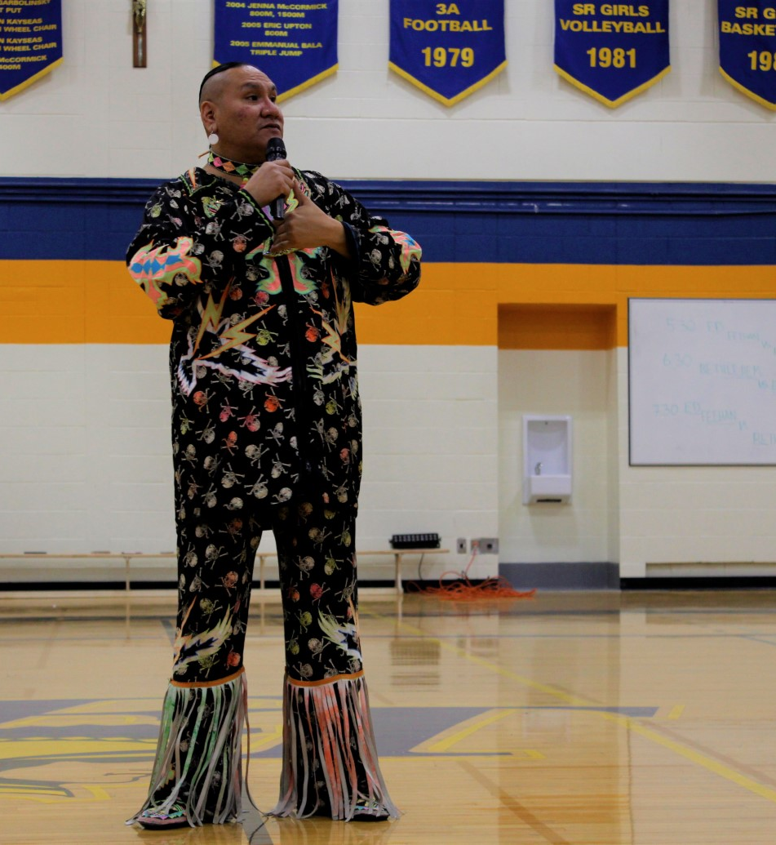
miyo pimâcihowin: Indigenous Cultural & Wellness Program
Land based learning
Ceremony
Elder
Cultural Arts – Beading, art, making moccasins, drums, ribbon shirts and shirts
Indigenous Spirituality
Smudging
Your other areas of interest!

Slide 31
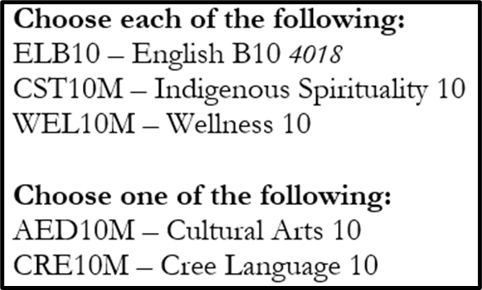
Grade 10 miyo pimâcihowin program
In addition, from the above compulsory courses section, you must select and register for:
Science 10 and Financial Literacy 10
Indigenous Studies 10 or History 10
A 10-level Math

Slide 32
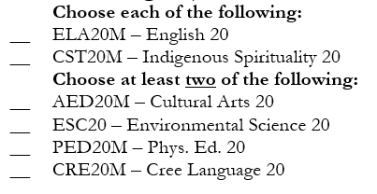
Grade 11 miyo pimâcihowin program
In addition, from the above compulsory courses section, you must select and register for:
Indigenous Studies 20 or History 20 or PSY30
At least one 20-level Math
At least one 20-level Science (if you have not already selected ESC20)

Slide 33
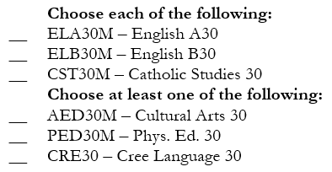
Grade 12 miyo pimâcihowin program
In addition, from the above compulsory courses section, you must select and register for:
Indigenous Studies 30 or History 30

Slide 34
You can register for cyber school classes online at: https://www.gscs.ca/cyb
This is a separate school within GSCS
Contact with Cyber School and your teacher are via email
Students who are successful are most often independent learners and have developed strong time management skills

Slide 35
Graduation Requirements for Students Entering Gr. 10 or 11 in Sep 2025 (Yellow = Electives)
GRADE 10 | GRADE 11 | GRADE 12
Catholic Studies 10 | Catholic Studies 20 | Catholic Studies 30
English 10 | English 20 | English 30
Science 10 | A Minimum of 1 Level 20 Science | History 30 OR Indigenous Studies 30
Math: MWA 10 OR MFP 10 | A Minimum of 1 Level 20 Math | 1
History 10 OR Indigenous Studies 10 | 1 | 2
Wellness 10 | 2 | 3
Financial Literacy 10 | 3 | 4
1 | 4 | 5
2 | 5 | 6
3 | 6 | 7

Slide 36
Graduation Requirements for Students Entering Gr. 12 in Sep 2025 (Yellow = Electives)
GRADE 10 | GRADE 11 | GRADE 12
Catholic Studies 10 | Catholic Studies 20 | Catholic Studies 30
English A10 | English 20 | English A30
English B10 | A Minimum of 1 Level 20 Science | English B30
History 10 OR Indigenous Studies 10 | A Minimum of 1 Level 20 Math | History 30 OR Indigenous Studies 30
Math: MWA 10 OR MFP 10 | At least one of: History 20 OR Indigenous Studies 20 OR Psychology 30
Science 10 | 1 | 1
Wellness 10 | 2 | 2
1 | 3 | 3
2 | 4 | 4
3 | 5 | 5

Slide 37
Entering Grade 10 or 11 Sept 2025

Slide 38
Here we go Entering Gr 10 and 11’ers! Your to-do list…. Step 1: Review your current timetable (provided) Step 2: Gr. 9’s, please review your Semester 1 Report Card. Gr. 10’s, please review your transcript.
Are your courses and marks accurate?
If you see any errors, please bring this to our attention.

Slide 39
Entering Gr. 10 or 11 (continued) Step 3: Use your report card AND your current timetable and neatly:
Put an X beside classes that you have not passed or did not take
Assume you will pass all semester 2 classes

Slide 40
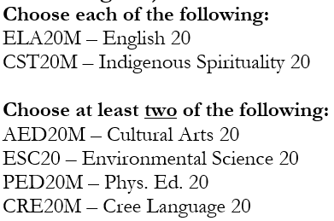
Entering Gr. 10 or 11 Course Selection Sheet (continued) Step 4: Please ✔ if you need LAS or EAL tutorials next year. Step 5: Would you like to be part of the Grade 10 miyo pimâcihowin Program?

Slide 41
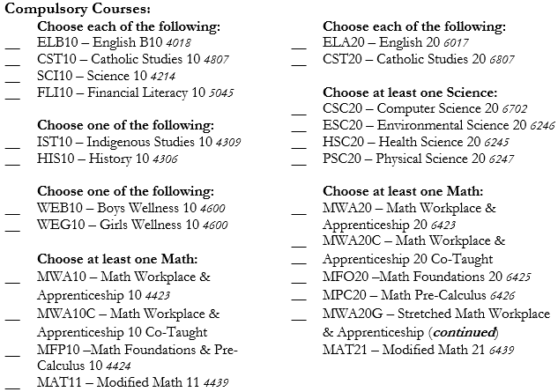
Entering Gr. 10 or 11 Course Selection Sheet (continued) Step 6: Required Classes- Place a √ beside classes you need to take next year. *Bridge Math students do not select a Math for next year - this will be based upon teacher recommendation

Slide 42
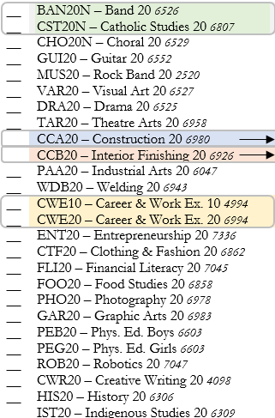
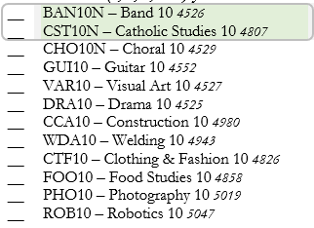
Entering Gr. 10 or 11 Course Selection Sheet (continued) Step 7: Electives - Place a number (1,2,3,4,5) beside classes you want to take next year. Rank these electives, so 1 is your favourite, then 2, then 3, then 4, etc.
SUBMIT all sheets to a counsellor or administrator prior to leaving!

Slide 43
Entering Grade 12 Sept 2025

Slide 44
Graduation Requirements for Students Entering Gr. 12 in Sep 2025 (Yellow = Electives)
GRADE 10 | GRADE 11 | GRADE 12
Catholic Studies 10 | Catholic Studies 20 | Catholic Studies 30
English A10 | English 20 | English A30
English B10 | A Minimum of 1 Level 20 Science | English B30
History 10 OR Indigenous Studies 10 | A Minimum of 1 Level 20 Math | History 30 OR Indigenous Studies 30
Math: MWA 10 OR MFP 10 | At least one of: History 20 OR Indigenous Studies 20 OR Psychology 30
Science 10 | 1 | 1
Wellness 10 | 2 | 2
1 | 3 | 3
2 | 4 | 4
3 | 5 | 5

Slide 46
SCIENCE PATHWAYS
Notes:
1 LEVEL 20 MATH AND 1 LEVEL 20 SCIENCE ARE REQUIRED. ALL OTHER MATH AND SCIENCE CLASSES BEYOND THESE ARE ELECTIVES.
MATH AND SCIENCE ELECTIVES SHOULD BE CONSIDERED BASED ON FUTURE PLANS, ABILITY AND INTEREST.
IF YOU ARE INTERESTED IN TAKING A 20 LEVEL SCIENCE IN GRADE 10, YOU MUST HAVE AN 80 PERCENT AVERAGE IN YOUR GRADE 9 SCIENCE AND MATH COURSES. AS WELL YOU WILL BE EXPECTED TO MAINTAIN AN 80 PERCENT AVERAGE IN YOUR GRADE 10 SCIENCE AND MATH COURSES IN TERM 1 OF NEXT YEAR.

Slide 47
University News
*For the most up-to-date information, always check the U of S website https://www.usask.ca/
Direct Entry College Requirements
Agriculture & Bioresources
BIO30, CHE30, MFO30 or MPC30
Education
(includes SUNTEP, NORTEP and ITEP Programs- these programs are rolling admission, however)
30-level science
MFO 30 or MPC30
30 level Fine Art or a 30 level Language (other than English)
Kinesiology
BIO 30, CHE 30 or PHY 30, MFO 30 or MPC 30

Slide 48
Direct Entry College Requirements
Arts and Science
MFO30
Some university-level courses require high school level prerequisites. Please check www.usask.ca for degree requirements
Edwards School of Business
MFO30 or MPC30 (MPC30 recommended)
Engineering
Minimum of 70% required in MPC30, CHE30 and PHY30
Calculus 30 recommended

Slide 49
Non-Direct Entry College Requirements Note: A student has a minimum of 1 year of study at the university level
Medicine, Dentistry, Veterinary Medicine
MPC30 (recommended) or MFO30,
BIO30, CHE30, PHY30
Pharmacy, Nutrition and Dietetics
MPC30 (recommended) or MFO30
BIO30, CHE30
PHY30 (recommended)
Nursing
MFO30 or MPC30
BIO30
CHE30 (recommended)

Slide 50
Helpful information about Post-Secondary programs can be found:
Check it out!

Slide 51
Here we go, our future Grade 12’s! Step 1: Review your current timetable (provided) Step 2: Review your Ministry Transcript
Are your name, address, birthdate accurate? Make any corrections on your Ministry Transcript.
Is your credit count accurate?
If you see any errors, please circle the concern and write a brief note. We will review this upon submission.

Slide 52
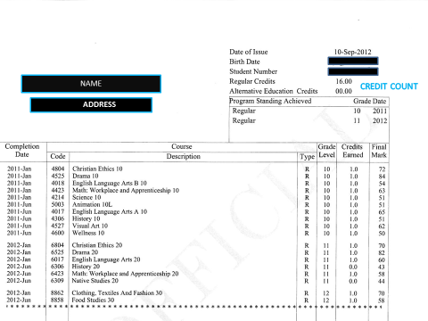

Slide 53
Grade 12 Course Selection Sheet (continued) Step 3: Use the Ministry Transcript AND your current timetable and neatly:
Write your name on the Course Selection Card
Assume you will pass all Semester 2 classes
Step 4: Please put a ✔ if you need LAS or EAL tutorials next year.

Slide 54
Step 5: If registering in miyo programming- please note which courses are offered!
Please check the box if interested in being apart of the miyo program.
Then select the classes that you need to take.

Slide 55
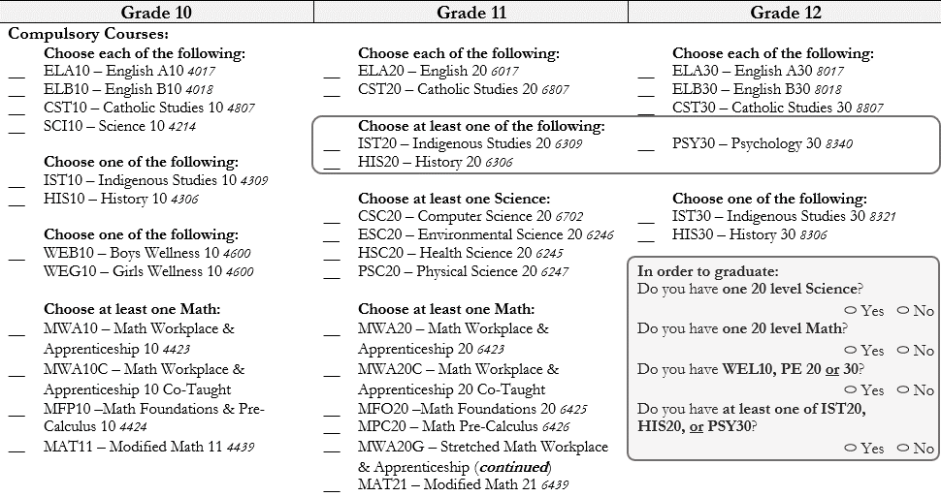
Grade 12 Course Selection Sheet (continued) Step 6: At the top of the Selection Card- Place a ✔ beside the Required classes you need to take next year. If you have been unsuccessful OR have not taken a required course, you must sign up for this next year!
NOTE: If you are currently taking MWA Stretch with Mr Lashyn in P2, you must select MWA20G.

Slide 56
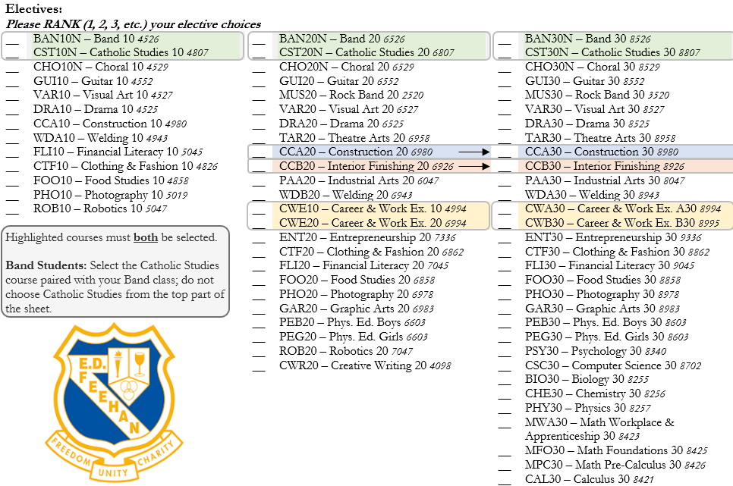
Step 7: Electives- Place a number (1,2,3,4) beside classes you want to take next year. Rank these electives, so 1 is your favourite, then 2, then 3, etc.
Reminder: 2 credit classes (Work Ed, House Construction) Note: If you are in Band - select the CST-N (grey) that is beside the Band class

Slide 57
Graduation Requirements for Students Entering Gr. 12 in Sep 2025 (Yellow = Electives)
GRADE 10 | GRADE 11 | GRADE 12
Catholic Studies 10 | Catholic Studies 20 | Catholic Studies 30
English A10 | English 20 | English A30
English B10 | A Minimum of 1 Level 20 Science | English B30
History 10 OR Indigenous Studies 10 | A Minimum of 1 Level 20 Math | History 30 OR Indigenous Studies 30
Math: MWA 10 OR MFP 10 | At least one of: History 20 OR Indigenous Studies 20 OR Psychology 30
Science 10 | 1 | 1
Wellness 10 | 2 | 2
1 | 3 | 3
2 | 4 | 4
3 | 5 | 5

